Slide 1

20CS821 – PROJECT WORK
K.S.R.COLLEGE OF ENGINEERING (Autonomous) Tiruchengode -637215
AI-Enhanced Personalized Learning
Support System
SUPERVISOR:
Name : Dr. S. VADIVEL
Designation : ASSISTANT PROFESSOR
Department : COMPUTER SCIENCE AND ENGINEERING
DONE BY:
SUBASHREE N (73152113105)
SURENDHAR N D (73152113109)
SABESH MURALI M (73152113089)

Slide 2
ABSTRACT
The AI-powered Personalized Learning Platform tailors learning pathways to each student's strengths, interests, and goals. It provides adaptive quizzes, personalized improvement recommendations, and real-time support for grammar, pronunciation, and essay grading. Teachers can track progress, assign quizzes, and engage in a community forum. Administrators manage users and system settings while overseeing interactions. Key features include AI-driven quizzes, skill tracking, real-time feedback, and a collaborative community space. The platform evolves based on student performance, promoting personalized growth and enabling teachers and administrators to enhance learning outcomes.

Slide 3
Content
INTRODUCTION
EXISTING SYSTEM
DRAWBACKS OF EXISTING SYSTEM
PROPOSED SYSTEM
ADVANTAGES OF PROPOSED SYSTEM
ARCHITECTURE
MODULE EXPLANATION

Slide 4
INTRODUCTION
Every student learns the same way, even though each one has different strengths and needs. Sarah, for example, struggles with grammar but is good at math, while James finds the lessons too easy. The current system doesn’t adapt to their unique needs, making it hard for them to succeed.
What if there was a way to help Sarah improve her grammar while challenging James with harder material? What if learning could be tailored to each student’s abilities and interests?
Our AI-powered platform does just that. It creates personalized learning paths based on each student’s strengths, weaknesses, and goals. It provides adaptive quizzes, instant feedback, and real-time support to guide students through their learning journey.
With this platform, every student gets the support they need, when they need it, and can learn at their own pace. Teachers can easily track progress and offer tailored guidance, making education more effective for everyone.

Slide 5
EXISTING SYSTEM
In the current educational system, personalized learning is limited. Students follow a fixed curriculum with predefined assessments, lacking customization based on individual progress. Existing platforms offer standard content but don’t adapt to students’ changing needs or skill levels. Teachers often rely on manual tracking tools, making personalized support difficult. Additionally, most systems lack real-time AI support for grammar, pronunciation, or essay feedback, and collaboration is restricted to basic forums or messaging systems.

Slide 6
DRAWBACKS OF EXISTING SYSTEM
Lack of Personalization: Students receive the same content, even though they learn at different paces.
Fixed Assessments: Quizzes and tests don’t adjust to a student’s performance or abilities.
Manual Progress Tracking: Teachers struggle with time-consuming manual tracking of student progress.
Limited Feedback: Feedback isn’t real-time or detailed enough to help students improve.
No Intelligent Support: No real-time, AI-powered help for things like grammar or essay grading.
Limited Collaboration: Basic forums that don’t allow for real-time interaction or peer-to-peer support.

Slide 7
PROPOSED SYSTEM
The proposed AI-driven Personalized Learning Platform offers a dynamic, adaptive approach to learning. It creates personalized learning paths based on each student's strengths, interests, and skills. AI-generated quizzes adapt to performance, with continuous progress tracking adjusting skill ratings and content recommendations. If a student struggles, the system adjusts their learning path and provides feedback for improvement.
An intelligent support system offers real-time help for grammar, pronunciation, and essay evaluation. Students receive tailored feedback after each test, and the system tracks progress daily. Teachers can monitor progress, assign quizzes, and engage in community discussions, while administrators manage users and system performance. This platform ensures a personalized, evolving learning experience, enhancing education for both students and educators.

Slide 8
ADVANTAGES OF PROPOSED SYSTEM
Personalized Learning: The platform adapts learning paths to fit each student's unique needs, ensuring they get the right content at the right time.
Dynamic Assessments: AI-generated quizzes that change based on a student’s abilities, making assessments more relevant.
Instant Feedback: Students receive immediate feedback, helping them to improve quickly and stay motivated.
Automated Tracking: Teachers can monitor student progress in real-time, freeing up time for more focused support.
AI Support: Real-time, AI-driven help for grammar, pronunciation, and essay grading.
Enhanced Collaboration: A community space for students and teachers to interact, ask questions, and collaborate in real time.

Slide 9
ARCHITECTURE
Frontend (React): User interface for students, teachers, and administrators.
Backend (Express.js): Manages API calls, database interactions, and system logic.
AI/ML Models: Personalized quiz generation, performance tracking, and real-time feedback.
Database: Stores student profiles, quiz results, progress data, and community interactions.
Support System: Provides real-time feedback for grammar, pronunciation, and essay grading.
Admin Control Panel: For user management, system configuration, and performance tracking.

Slide 10
MODULES
Student Profile Module: Stores student data such as strengths, interests, goals, and progress.
Quiz Generation Module: AI-driven quizzes tailored to individual student profiles, adjusting based on performance.
Skill Assessment & Feedback Module: Provides personalized feedback on quizzes, essays, grammar, and pronunciation.
Progress Tracking Module: Monitors student performance and adjusts learning paths accordingly.
Teacher Dashboard: Allows teachers to track student progress, assign quizzes, and provide feedback.
Admin Panel: Manages users, community interactions, and system settings.
Community Forum: A collaborative platform for students, teachers, and administrators to interact and share knowledge.

Slide 11
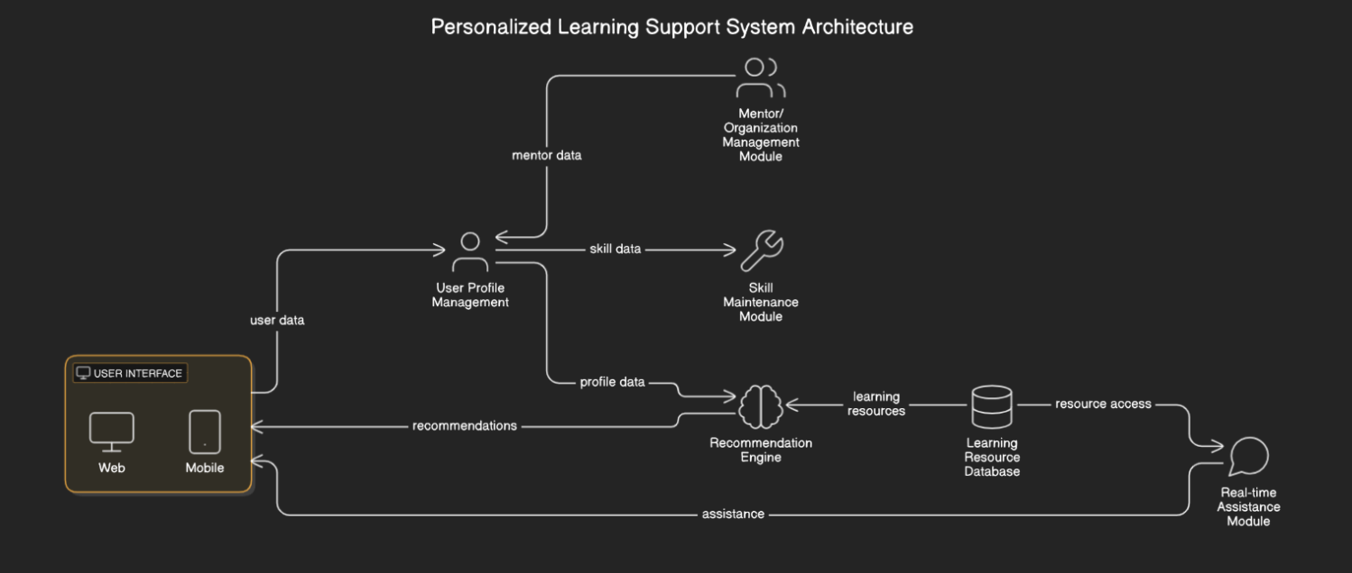
Architecture Diagram

Slide 12
1. User Interface (UI) Module
Inputs:
User profile data (learner, mentor, or administrator)
Learning resources (e.g., articles, videos, quizzes)
Real-time data from other modules (e.g., progress tracking, quiz results, feedback)
User actions (e.g., navigation, quiz attempts, feedback submissions)
Outputs:
Personalized learning paths (for learners)
Learning progress dashboard (for learners, mentors, and administrators)
Notifications (e.g., quiz reminders, new content, feedback)
Visual feedback on learner’s achievements and milestones
User interactions (e.g., selecting resources, taking quizzes)

Slide 13
2. User Profile Management Module
Inputs:
User registration data (skills, interests, goals)
Learner's interactions (quiz performance, content views, preferences)
User progress (learning history, quiz attempts, feedback)
Outputs:
Dynamic user profiles (updated based on performance and interactions)
Learner's skill level and learning goals
Data for the Recommendation Engine (e.g., user interests, gaps in knowledge)
Personalized learning path parameters (e.g., skills, interests, goals)

Slide 14
3. Learning Resource Database Module
Inputs:
New learning materials (articles, videos, quizzes, etc.)
Categorization tags (e.g., subject, difficulty level, skill type)
Updates from the Recommendation Engine (suggested resources for specific users)
Outputs:
Categorized and tagged resources available for recommendation
Resource metadata (e.g., difficulty level, length, content type)
Learning resources for the Recommendation Engine to suggest based on user profiles

Slide 15
4. Recommendation Engine Module
Inputs:
User profile data (from User Profile Management)
Learner’s learning history and progress
Learning resource data (from Learning Resource Database)
Content-based and collaborative filtering algorithms
Learner’s feedback on suggested resources
Outputs:
Personalized learning paths (sequence of learning resources tailored to the learner)
Recommended learning resources (based on content and collaborative filtering)
Adaptive learning path updates (based on learner's progress and changing goals)
Recommended skill maintenance quizzes for learners (from Skill Maintenance Module)

Slide 16
5. Skill Maintenance Module
Inputs:
Learner’s progress data (from User Profile Management)
Learning history and performance data (from User Profile Management and Recommendation Engine)
Spaced repetition algorithm parameters
User preferences for quiz frequency
Learning content data (for quiz generation)
Outputs:
Adaptive quizzes (tailored to learner's skill gaps and performance history)
Difficulty-adjusted quizzes (based on the learner’s previous answers)
Suggested quiz schedules (daily, weekly, etc.)
Quiz results and progress updates (to be reflected in User Profile Management)

Slide 17
6. Real-time Assistance Module
Inputs:
User’s written content (e.g., essays, reports)
User’s spoken input (e.g., pronunciation samples)
Learner’s context (e.g., language level, goals)
Outputs:
Grammar and spelling corrections (for written content)
Pronunciation feedback (for speech input)
Essay scores and feedback (automated grading with detailed suggestions)
Real-time feedback on essay quality (e.g., coherence, organization)
Detailed error reports and suggestions for improvement (for learners)

Slide 18
7. Mentor/Organization Management Module
Inputs:
Mentor's actions (e.g., assigning groups, tracking learner progress)
Learner's progress and performance data (from User Profile Management)
Feedback from learners and mentors (e.g., course feedback, progress reports)
Group creation and management details
Outputs:
Group assignments (for learners under a mentor’s guidance)
Learning progress reports (for mentors and administrators)
Communication tools for mentors and learners (e.g., messaging, feedback)
Adjusted learning paths (based on mentor feedback)
Notifications to mentors (about learner activities, feedback requests)

Slide 19
THANK YOU

